Slide 1
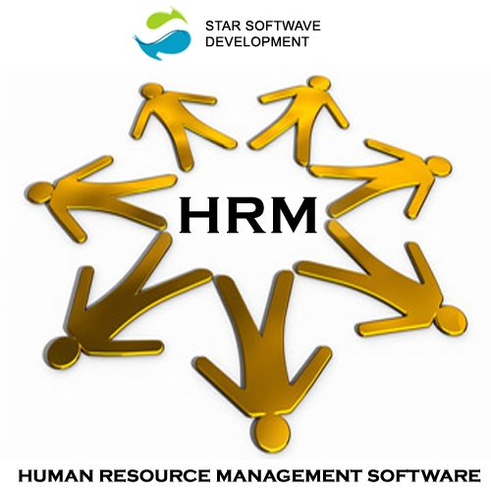

Human Resource Management

Slide 2
HRM Overview
Human Resource Management (HRM) is the function within an organization that focuses on recruitment of, management of, and providing direction for the people who work in the organization. Human Resource Management can also be performed by line managers.
Human Resource Management is the organizational function that deals with issues related to people such as compensation, hiring, performance management, organization development, safety, wellness, benefits, employee motivation, communication, administration, and training.
It is concerned with philosophy, principles, policies and practices related to human aspect of management.
It aims at achieving organizational objectives through the efficient and effective mobilization of human resources.

Slide 3
Human Resource Management
“Human” represents the dimension of HRM which relates to the soft aspects such as commitment of employees through participation and the most important assets being the employees.
“Resource” represents the hard aspects such as the strategy link of HRM and the importance of efficient utilization of employees.
“Management” represents the role of HRM as part of management that implies that it’s not only an administrative function that carries out the formulated policies but also a managerial function that contributes to strategy formulation.
Notes:
Developed by N. Zaidi

Slide 4
Contd.
According to Edwin Flippo ,
HRM as “planning, organizing, directing, controlling of procurement, development, compensation, integration , maintenance and separation of human resources to the end that individual, organizational and social objectives are achieved".
According to Storey J.
Human resource management is a distinctive approach to employment management which seeks to achieve competitive advantage through the strategic deployment of a highly committed and capable workforce, using an array of cultural, structural and personnel techniques
According to Donnelly and Gibson,
HRM is the process of accomplishing organizational objectives by acquiring, retaining, terminating, developing and properly using the human resources in an organization.

Slide 5
Evolution of HR
The terminology used to describe the role and function of workers has evolved from "personnel" to "industrial relations" to "employee relations" to "human resources."
The need for an organized form of HRM emerged during the industrial revolution from 18th century.
F.W. Taylor invented principles of scientific management in the 19th century.
He suggested to plan work and gave methods to maximize productivity and minimize inefficiencies.
In his studies, he explained less about humanization of workplaces and focused more on output from the workers.
The Hawthorne studies (Elton Mayo and Fritz Roethlisberger,1924) laid the foundation for the human relations movement and explain why human elements are important to rise productivity. Personnel Management introduced.
1950 to till date: After 1950 The HR concept has started narrowly. From 1997 to 2000 HR concepts tried to achieve the recognition. After that it has recognized. Some organization started to set HR department

Slide 6
Functions of HRM
Human Resource Planning:
Human resources planning is a process that identifies current and future human resources needs for an organization to achieve its goals. Human resources planning should serve as a link between human resources management and the overall strategic plan of an organization.
Recruitment & Selection:
Recruitment can be defined as searching for and obtaining a pool of potential candidates with the desired knowledge, skills and experience to allow an organization to select the most appropriate people to fill job vacancies against defined position descriptions and specifications.
Performance Appraisal:
Performance appraisal is a formal and structured process and relies heavily on benchmark comparison. Such appraisal results in an assessment of the strengths and weaknesses of a manager and his ability to deliver on a stated benchmark goal.
Training and Development :
Training and development is a function of human resource management concerned with organizational activity aimed at bettering the performance of individuals and groups in organizational settings.
Compensation and Remuneration:
Compensation and benefits (abbreviated “C&B”) is a sub-discipline of human resources, focused on employee compensation and benefits policy-making. It is also known in the UK as “total reward” and as “remuneration” in Australia and New Zealand. Job Evaluation, Wage and salary, incentive, fringe benefits.

Slide 7
HRM Landscape
HR- Strategy & Planning
Talent Development
Change Management
Learning
Talent Acquisition
Work
Retention
Candidate Selection
Compensation & Benefits
Organization
IT
Social Media
Controlling

Slide 8
Challenges to HRM
Increasing cut-throat competition
Globalization
Technological Advances
Workforce diversity
Women work as work force
Rising employees' expectations
Impact of new organizational policies
Impact of new economic policies or Government policies.
Retention and Retrenchment of employees

Slide 9
System Model of HRM
Input
Process
Output
Organizational Plan
HR Plan
Job Analysis
Key Functions of HRM
Organizational
Goals achievement
Quality of work life
Productivity
Readiness for change
Personal
Commitment
Competence
Congruence
Feedback

Slide 10
4C’s HR Policies that have to be achieved
Commitment
Competent
Congruence(Compatibility)
Cost effectiveness

Slide 11
Role of HR Executives
Service provider –
To complete the demand of employees by the supply of effective employees. Management also needs to gather information such as market statistics, pay rates and labor laws, legislations and various employee related issues.
Facilitator –
They act as a facilitator when training and development actions are planned and conducted and when performance appraisals are done.
Consultant –
While supervising the employees, managers face many problems. So they consult with employees for their personal growth.
Auditor –
HR specialists are responsible for ensuring that all members of the management perform their respective roles efficiently and also ensures that there is effective use of the human resources of the organization.

Slide 12
Role of HR Executives
Change agent –
HR executive is the person that helps to the organizations to implement changes and encourage employees to adapt changes.
Employee advocate –
HR executives are the link between the top management and the employees. The concerns of the employees are first reported to the HR personnel. They report these issues to the top management and try to resolve the issues.
HR in any organisation has multiple roles to play. They may have to perform all the mentioned roles at different stages in their career as HR personnel.

Slide 13
HUMAN RESOURCE PLANNING
It is the continuous process of planning the human resource of an organization to meet the demand in terms of numbers and the quality.
It involves getting the right number of qualified people into the right jobs at the right time in order to achieve organizational objectives.
It is a process of comparing human resource demand by human resource supply for current scenario or Future.
In light of the organization’s objectives, strategies, HRP is the process of analyzing an organization’s human resource needs and developing plans, policies, and systems to satisfy those needs.
It is important for a firm to plan its workforce requirements in advance.

Slide 14
DEFINITION
According to Edwin B. Geisler:-
Human Resource planning is, "the process by which a firm ensures that it has the right number of people and the right kind of people, at the right places, at the right time, doing things for which they are economically mast useful".
According to Bruce P. Coleman:-
Manpower Planning is, "the process of determining manpower requirements in order to carry out the integrated plan of the organization.
According to Terry L. Leap and Michael D. Crino,:-
“HRP includes estimation of how many qualified people are necessary to carry out the assigned activities, how many people will be available and what, if anything must be done to ensure that personnel supply equals personnel demand at the appropriate point in future.”
Important measures for human resource planning
Identify Requirement - forecasting of human requirement involves the determining the number and types of employees needed.
Availability of Human Resource- After analyzing the requirements, the firm determines whether there is a surplus or shortage of manpower.

Slide 15
NEED of HRP
Forecast personnel requirement : To avoid the situations of surplus or deficiency of manpower in future, it is important to plan your manpower in advance. For this purpose a proper forecasting of futures business needs helps you to ascertain our future manpower needs. From this angle, HRP plays an important role to predict the right size of manpower in the organization.
Cope with change: HRP enables an enterprise to cope with changes in competitive forces, markets, technology, products and government regulations. Such changes generate changes in job content, skills demands and number of human resources required.
Creating highly talented personnel: Since jobs are becoming highly intellectual and professionalized, HRP helps prevent shortages of personnel caused by attrition. Further technology changes would further upgrade or degrade jobs and create manpower shortages. In these situations only accurate human resource planning can help to meet the resource requirements. Further HRP is also an answer to the problems of succession planning.
Protection of weaker sections : A well-conceived personnel planning would also help to protect the interests of the SC/ST, physically handicapped and backward classes.

Slide 16
Contd.
International strategies : International expansion strategies largely depend upon effective HRP. With growing trends towards global operations, the need for HRP further becomes more important as the need to integrate HRP more closely into the organization keeps growing. This is also because the process of meeting staffing needs from foreign countries grows in a complex manner.
Increasing investments in HR : Another importance is the investment that an organization makes in human capital. It is important that employees are used effectively throughout their careers. Because human assets can increase the organization value tremendously as opposed to physical assets.

Slide 17
PROCESS OF HRP
1. Analyzing Organizational Plan for HR
2. Analyzing Objectives of Human Resource Planning
3. Forecasting Demand for Human Resources
4. Forecasting Supply of Human Resources
5. Matching Demand & Supply
6. Monitoring and Control

Slide 18
1. Analyzing Organizational Plan for HR
The process of HRP planning begins with analyzing the overall plans & objectives of the firm.
The reason for this is HR plans stem from the business plan.
Analysis of business plan into sub-sectional plans like production, sales, finance, marketing etc helps access the requirements of HR for each department.
Analysis of organizational and departmental objectives provide human resource requirements in the firm.
If the objective of the company is to grow, expand or increase sales, then, the requirements for manpower will be changed for the company or respective departments.
Hence, HRP needs to be made according to the organizational plans.

Slide 19
2. Analyzing Objectives of Human Resource Planning
The next step is to analyze the objectives of HRP.
The main purpose of HRP is to find the right quantity & quality of workforce in the organization, who will in turn benefit the company, by helping it achieve its various goals.
HRP aims at matching employees abilities with organizational requirements.
HRP also aims at maximizing the future return on investment in human resources.

Slide 20
3. Forecasting Demand for Human Resources
In this step, the management tries to determine how many employees are going to be required in the organization at a particular point of time.
However, this varies from time to time depending upon both internal and external factors.
External factors include competition, changes in technology, government policies, economic environment etc.
Internal factors include growth & expansion, change in leadership, employees resignation, retirement, termination, death etc.
Hence, both these factors have to be taken into consideration while forecasting the demand for human resources.
There are various techniques for forecasting the demand for human resources.

Slide 21
4. Forecasting Supply of Human Resources
After forecasting the demand for human resources, the next step is to forecast the supply of human resources.
It gives an estimate about the quantity & quality of people available from internal & external sources.
Forecasting of human resource begins with the current human resource inventory or human resource audit- which contains information about the present human resources in an organization.
It reveals the number & type of human resources available.
This indicates whether demand is more than supply or supply is more than demand for human resources.

Slide 22
5. Matching Demand & Supply by HRP
Once demand & supply of human resources of an organization are forecasted, the two need to be matched or reconciled.
Such reconciliation will reveal either shortage or surplus of human resources in future.
Accordingly, action plans can be prepared to strike a balance between the two.
Incase of shortage of HR requirements, it can be met through recruitment, transfers, promotions, retentions etc.
Incase of surplus human resources, it can be rectified through redeployment, VRS schemes, retrenchment etc.

Slide 23
6. Monitoring and Control
The final step in HRP is monitoring and control.
Once action plans are implemented, these need to be continuously regulated and monitored against standards.
Monitoring helps reveal deficiencies and immediate corrective action can be taken to remove the deficiency.
In case of changes in the business environment, earlier plans need to be modified.

Slide 24
Management of Workforce
Senior
Promotion
Hiring
Losses
From outside
Retirement, Turnover
Promotion in
Professional
Junior
Growth

Slide 25
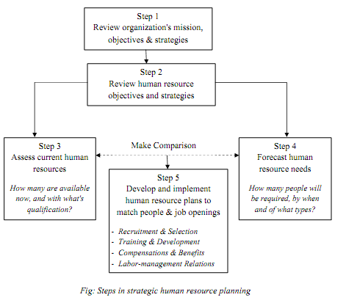

Slide 26
BENEFITS OF HRP
HRP meets organization need for the right type of people, in the right number, at the right place & time.
HRP helps maintain a balance between demand for & supply of human resource.
HRP makes optimum use of human resources.
Manpower shortfalls & surpluses are avoided.
HRP helps firms create and develop training & succession planning for managers and employees.
It provides multiple gains to the employees by way of promotions, incentives and other benefits.

Slide 27
Contd.
Some of the problems of managing change may be foreseen in advance and their consequences mitigated. Consultation in advance with affected groups can take place at an early stage, thus possible to avoid resistance.
HRM compels management to assess critically the strengths & weaknesses of its employees on continuous basis and take corrective measures for improvement.
Duplication of efforts and efforts is eliminated as a result of HRP & coordination of workers efforts can be improved.
With an increase in skills, productivity & job satisfaction of employees, the organization becomes the main beneficiary in terms of increase in profits, growth, prosperity & an edge over its competitors.

Slide 28
The Responsibility Assignment Matrix (RAM)
This is describes the participation by various roles in completing tasks for a business process.
Projects can involve large numbers of people often from different departments, functions and divisions of the business. The project manager is accountable for the project but this does not mean they are solely responsible for all the work involved. A Responsibility Matrix is used to define who in the organization is responsible for individual work elements and deliverables. By forming a matrix with the work breakdown structure and the organizational breakdown structure, responsibilities can be assigned to employees in form of tasks.
The matrix itself is a chart you can create using Microsoft Excel listing human resources across the top and activities down the left-hand side. The matrix can be as simple as placing a check mark under the resources name for a particular task

Slide 29
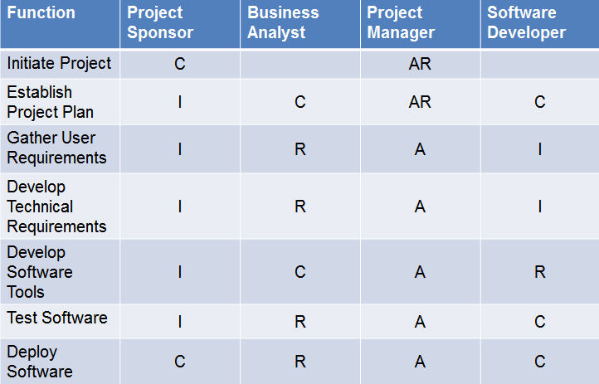
EXAMPLE for A RESPONSIBILITY ASSIGNMENT MATRIX (RAM)
R – Responsible, A – Accountable, C – Consult, I – Inform
(RACI CHART)

Slide 30
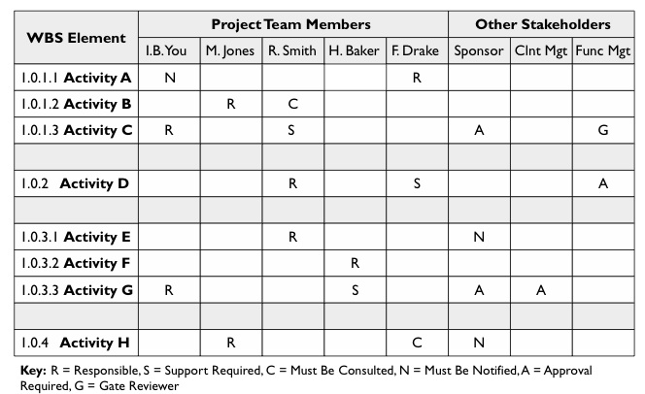
Another EXAMPLE for A RESPONSIBILITY ASSIGNMENT MATRIX

Slide 31
Why to use responsibility assignment matrix?
You can quickly see whether you have enough resources to complete the project in the time allotted.
You can also avoid confusion - especially if you use the roles listed below - over who is assigned to do what and when.
You can paint a realistic picture for perspective investors or to management by showing exactly how many resources are required to finish the project.

Slide 32

RECRUITMENT
The Process of generating a pool of qualified candidates for a particular job.
OR
The Process of discovering potential candidates.

Slide 33
STRATEGIC RECRUITING DECISIONS
FLEXIBLE STAFFING | DESCRIPTIONS
1. REGULAR EMPLOYMENT | Regular employment consists of continuous, predictable, and scheduled employment of six months' duration or longer. Regular employment may be full time or part time.
2. FULL-TIME OR PART-TIME | Full-time employment consists of a regular schedule of 37.5 hours per week. Part-time employment consists of a regular schedule of less than 37.5 hours per week.
3. INDEPENDENT CONTRACT | Perform specific services on a contract basis used in a number of areas, including building maintenance, security, and advertising/public relations.
4. TEMPORARY WORKERS | This is based on “try before you buy” approach . Employers who use temporary employees can hire their own temporary staff or use agencies supplying temporary workers. Such firms supply workers on a rate-per-day or per-week basis.
5. SEASONAL EMPLOYEES | Seasonal employees are hired to work on a part-time basis by companies that need extra help during a particular season, typically the Christmas season or crops harvesting.

Slide 34


Sources of recruitment
SOURCES OF
RECRUITMENT
INTERNAL
SOURCES
EXTERNAL
SOURCES

Slide 35
Contd.
Job Posting &
Bidding
INTERNAL
SOURCES
Promotions and
Transfers
Employee
Referrals
Re-recruiting former Employees & Applicants

Slide 36
Contd.
INTERNAL SOURCES
ADVANTAGES | DISADVANTAGES
Morale of Promotee Assessment of abilities Cost effective than external recruitment Causes a succession of promotions | Inbreeding Possible morale problems with those who not promoted “Political” infighting for promotions Need for management- Development program for change management

Slide 37
Contd.
Schools Colleges &
Universities
EXTERNAL
SOURCES
Labor
Unions
Media Sources
Employment Agencies

Slide 38
Contd.
EXTERNAL SOURCES
ADVANTAGES | DISADVANTAGES
New “blood” brings new perspectives Cheaper and faster than train to existing employees No possession or controlling over group of employees May bring new industry insights | May not select someone who will “fit” the job or organization May cause morale problems for internal Longer “adjustment” or orientation time

Slide 39


Selection
1
The Process of making a “Hire” or “No Hire” decision regarding each applicant for a job.
2
Selection is the process of choosing qualified individuals who are available to fill the positions in organization.
Or

Slide 40
Selection Methods
The Three most Common Methods used are:
1. Testing
2. Gathering Information
3. Interviewing
Testing can consist cognitive ability test, personality test, integrity test etc.
Common methods for gathering information include application forms and résumés, biographical data, and reference checking.
For interview, typical areas in which questions are asked included education, experience, knowledge of job procedures, mental ability, personality, communication ability, social skills.

Slide 41
Training and Development
Needs Analysis
Target Group
Learning Needs
Relevant situations
Design
How to provide training
Learning objectives and content
Methods and media
Costs and budgets
Operation
Trainer (internal or external)
Duration, Schedule
Infrastructure
Evaluation
Evaluation
Optimization

Slide 42
Training Approaches
Off the Job Lecture or study meterial
Off-side-Training
Conference or discussion
Internet based classes
Simulation
On the Job
Assistance or internship Job Rotation
Coaching Orientation training
Advantages of „On-the-job“ versus „Off-the-job“ -Training
On-the-Job
Off-the-Job
Natural and job-related
Lower cost for development
Immediate applicable for newly acquired knowledge
Immediate Feedback
Opportunity to easily monitor and evaluate development impacts
Motivation to learn
Exposure by external trainer
Professional learning environment
Focus on training, limited job-related disruptions
Networking among participants out of different functions and countries

